Slide 1
Software Estimation (WMS)
By Sam Ni
2/7/2017
Notes:
Chose this picture because it show a high performance team.
At Bleum we build high performance ODC’s
We are the ODC experts, this is all we do.
The CEO has a long history of building ODC’s first in India then in China

Slide 2
Objectives
Clarify
Two types estimation methods used in WMS project:
1. New Feature Development-Stories points.
2. Small enhancements-Function points.

Slide 3
Agenda
Story point estimation method when developing new feature in CDP team
Function point estimation method when implementing small feature in consulting team

Slide 4
Agenda
Story Point Estimation Concepts
Epic
Story points
Spike story
Sprint
Review and Retrospective Meeting
DoD(definition of done), COS(Criteria Of Satisfaction)

Slide 5
Agenda
Function Point Estimation Concepts
Function Overview
Solution Design
Changing file list

Slide 6
Story Point Estimation
Epic of estimation is mathematically intensive and can be quite accurate
- Science gives you theoretical numbers and is best implemented using software tools
- Science works best when informed by art
Story of estimation involves heuristics, rules of thumb, and judgment
- Art gives you practical help on real projects
- Art works best when supported and confirmed by estimation science
Spike

Slide 7
How Good an Estimator Are You?
 | Question
1 | The number of Greek characters
2 | Times of breathing for a human every day
3 | The diameter of the Earth
4 | The height of the highest building in China
5 | The average age of Chinese
6 | The permanent population in SH 2010
7 | The speed of the fastest train in China
8 | The average sleep time of adults
9 | The number of floors of Cloud-9 Mansion
10 | The number of countries/areas in the world
Result
24
23000
12713~12756 km
508m
75 years
19 million
394km/h
8h
53
224

Slide 8
Estimates, Targets, and Commitments
An Estimate is an analytical prediction of size, effort, time, and/or functionality
A Target is a statement of a business need: when the organization would like to deliver certain functionality at a given cost
A Commitment is a promise to deliver specific functionality by a certain date
* Realistically, we use the ART of estimation to align Estimates, Targets, and Commitments
Question: Who Owns Estimates, Targets, and Commitments?

Slide 9
Who Owns Estimates, Targets, and Commitments?
Estimates are owned by the technical staff/technical leadership
Targets are owned by the business staff
Commitments are owned jointly

Slide 10
What Are You Being Asked For?
An estimate?
A commitment?
A plan to meet a target?
Tips:
Make sure stakeholders understand and agree on what is being produced
When you’re asked to provide an estimation, determine whether you’re supposed to be estimating or figuring out how to hit a target

Slide 11
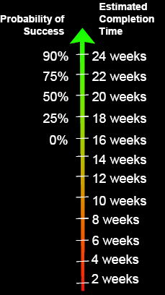
Estimates as Probability Statements
There is no such thing as a “single-point estimate” that is correct/meaningful
All estimates include probabilities—stated or implied (even if the estimator doesn’t know it)
An explicitly stated probability is one sign of a good estimate.

Slide 12
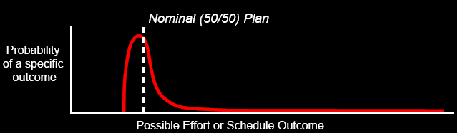
Estimate Probabilities
Estimate probabilities are not symmetrically distributed about a mean
Estimate probabilities tend to have a best case close to nominal case …and a worse case that is far away
Tips: The important thing is for you to know where in the range your commitment falls so that you can plan accordingly.

Slide 13
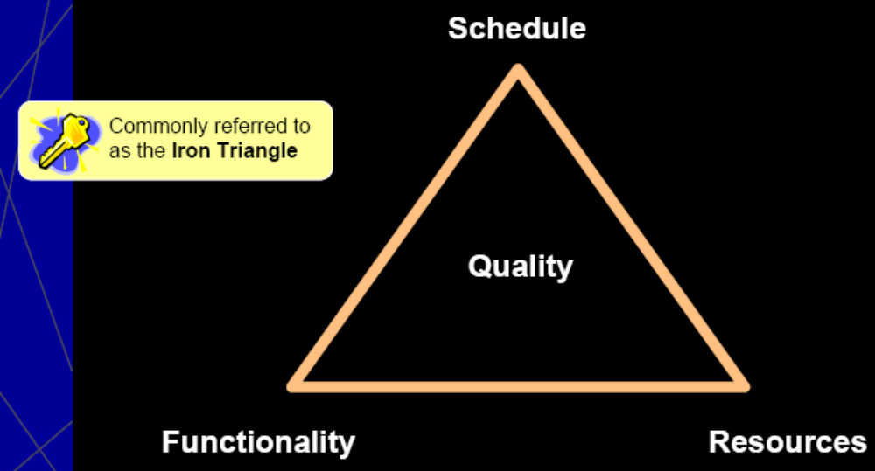
3 Basic Project Control Points

Slide 14
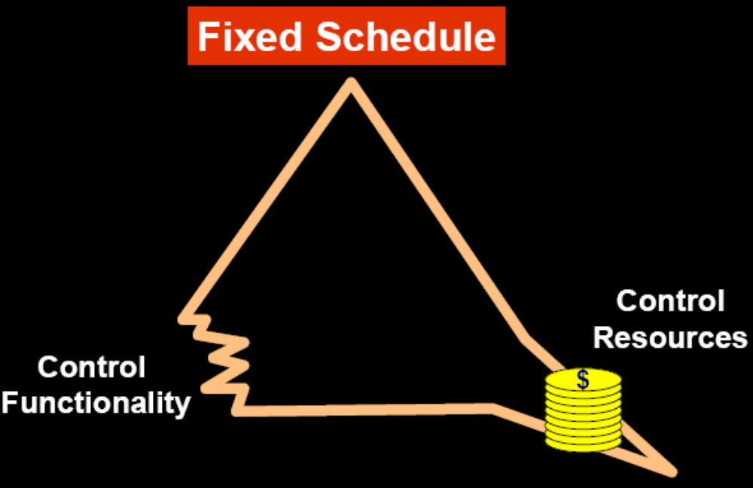
Building to a Schedule

Slide 15
Estimation and Control
Estimation’s role is to determine the level of risk in meeting business targets and to inform project planning and management
If the commitment is within roughly 20% of the estimated outcome, you can usually control the project to meet the commitment
> adjusting features, schedule, resources, etc.
If the gap between the commitment and the estimate is greater than 20%, meeting commitments becomes extremely difficult

Slide 16
Estimation and Scheduling
Estimation and Scheduling are separate activities
We estimate schedule, but this is different from scheduling
Good scheduling requires good estimation as input
If your time horizon is less than 6 months, creating a schedule is often better than estimating it

Slide 17
Estimation, Modeling, and Ground Truth
Estimation is Modeling
Project plans, schedules, requirements, designs, test cases, etc. are also models
We want our models to reflect reality
This is called Ground Truth
“If your map and terrain disagree, believe the terrain” – Military saying
Good estimates illuminate ground truth, which supports good decision making

Slide 18
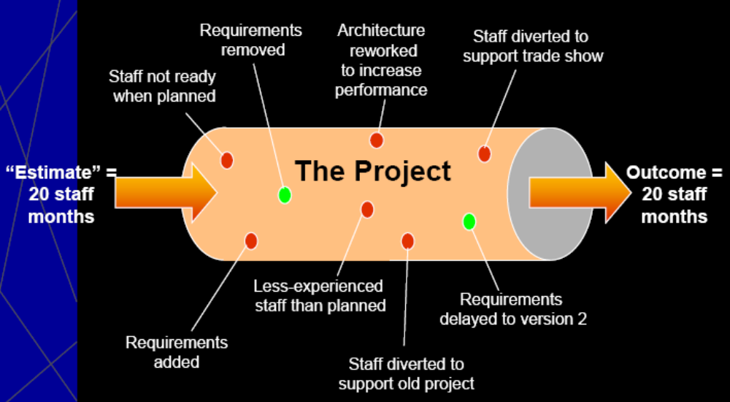
What Happens When We “Estimate” a Project?
Accurate Estimates
+ Commitment that’s in the ballpark
+ Effective project control
-----------------------------------------------------
= Project Results Close to the “Estimates”
Notes:
Projects change significantly from inception to delivery. Changes are usually significant enough that the project delivered is not the same as the project that was estimated. Nonetheless, if the outcome is similar to the estimate, we say the project met its estimate.

Slide 19

Good Estimate Characteristics
Captures uncertainty (has ranges)
Documents assumptions
Uses historical data
Uses multiple techniques and models
Has appropriate detail and precision

Slide 20
Estimation’s Real Purpose
The primary purpose of software estimation is NOT to predict a project’s outcome; it is to determine whether a project’s targets are realistic enough to allow the project to be controlled to meet them.
* In other words, a good estimate provides a clear enough view of the project reality to allow good decision making about how to control the project to hit its targets
Notes:
Estimates don’t need to be perfectly accurate as much as they need to be useful.
When we have the combination of accurate estimates, good target setting, and good planning and control, we can end up with project results that are close to the ‘estimates’.
As you’ve guessed, the word ‘estimate’ is in quotation marks because the project that was estimated is not the same project that ultimately delivered.
These dynamics of changing project assumptions are a major reason that we focus more on the art of estimation than on the science. Accuracy of 5% won’t do you much good if the project’s underlying assumptions change by 100%.

Slide 21
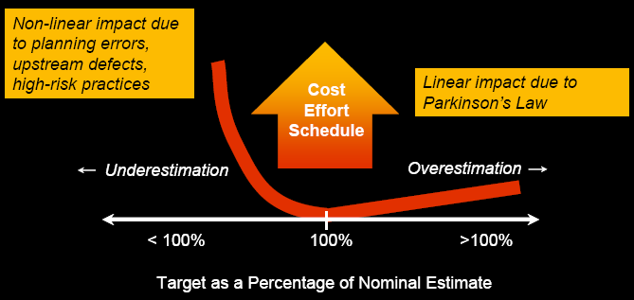
Effect of Estimation Accuracy
Tips: Don’t intentionally underestimate. The penalty for underestimation are more serious than the penalty for overestimation. Address concerns about overestimation through planning and control, not by biasing your estimates.

Slide 22
Benefits of Accurate Estimation
More efficient projects
Allows project to be completed at least cost
Allows project to be completed with shortest schedule
Fewer software development errors
Less schedule pressure, mistakes, overtime, staff turnover, etc.
Better coordination with non-software functions
Better budgeting

Slide 23
Benefits (cont.)
More credibility for development team
Improved status visibility
Project tracking depends partly on good estimates
Early risk information (possible mismatch between project scope and business goals)
Take action early, when it can do some good
Avoids late-in-the-project discovery that the project has been underestimated (which is difficult or impossible to correct)

Slide 24
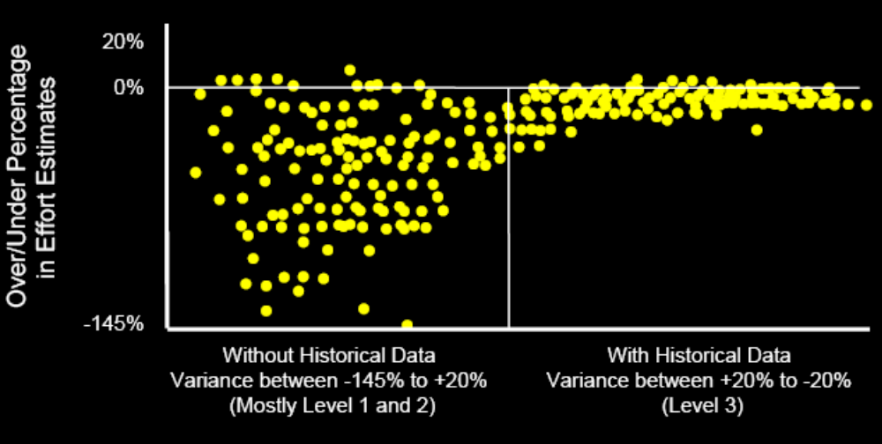
Estimation at Boeing
It is very difficult to make a vigorous, plausible, and job-risking defense of an estimate that is derived by no quantitative method, supported by little
data, and certified chiefly by the hunches of the managers.
— Fred Brooks (1975)

Slide 25
Key Points
Systemic tendencies are underestimation and use of unrealistically narrow ranges
These estimates tend to be unfounded and unrealistic on their face (if you know what to look for)
Good estimation depends on willingness to:
> Overestimate as often as you underestimate
> Use wide ranges early in a project
> Collect and use historical data

Slide 26
More Key Points
Effective estimation is not achieved through estimation alone
Some organizations estimate extremely well
Effective estimation must be supported by good project management
State-of-the-art results are achieved through a combination of:
> Good estimation
> Realistic target setting
> Effective control

Slide 27
Agenda
Critical Estimation Concepts
Estimation Error
Estimation Process

Slide 28
General Sources of Error
Inaccurate information about the project being estimated
Inaccurate information about the capabilities of the organization that will perform the project
Too much chaos in the project to support accurate estimation (that is, trying to estimate a moving target)
Inaccuracies arising from the estimation process itself

Slide 29
Sources of Estimation Uncertainty
Will the customer want Feature X?
Will the customer want the cheap or expensive version of Feature X?
How will Feature X be designed?
Which developers will be on the team?
When will the developers become available?
How productive will the programmers be?
How many bugs will the programmers put into the software?
How efficiently will they remove the bugs?

Slide 30
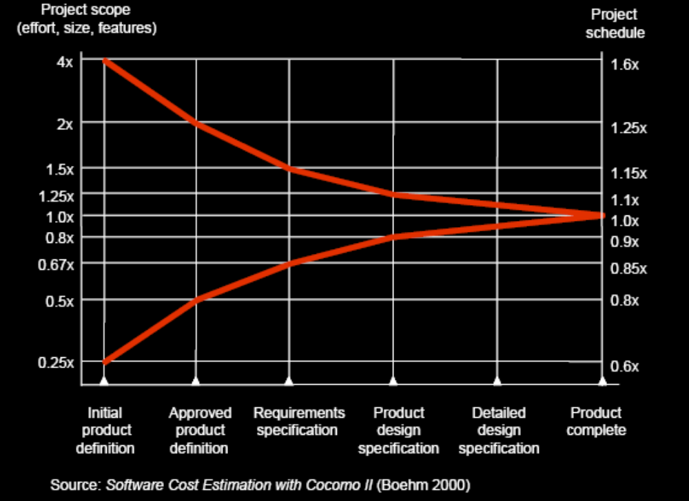
Estimate Accuracy—“Cone of Uncertainty”

Slide 31
Implications of the Cone of Uncertainty
Account for the Cone of Uncertainty by having estimate the best-case and worst-case ends of the range and estimate the likelihood that the actual result will fall within that range.
Meaningful commitments in the early middle of the project (~30%) are possible and appropriate
We can commit to narrow the cone

Slide 32
Common Project Chaos
Requirements that weren’t investigated very well in the first step
Inexperienced personnel
Poor designs that lead to numerous errors in the code
Poor coding practices that give rise to extensive bug fixing
Abandoning planning under pressure
Incomplete or unskilled project planning
Tips:
The source of chaos share two commonalities:
The first is that each introduces variability that makes accurate estimation difficult;
The second is that the best way to address each of these issues is not through estimation, but through better project control.

Slide 33
How can we narrow the cone?
Increase understanding of the requirements
Use prototyping, both UI and functional, to explore risks and unknowns
Do the highest risk work first
Negotiate feature commitments earlier rather than later
Tailor project lifecycle to meet business needs (e.g., go iterative if appropriate)

Slide 34
More Lessons:
To deal with unstable requirements, consider project control strategies instead of or in addition to estimation strategies.
Include all necessary software development activities in your estimation, not just coding and testing.
Don’t give off-the-cuff estimates. Even a 15-minute estimate will be more accurate.

Slide 35
Agenda
Critical Estimation Concepts
Estimation Error
Estimation Process

Slide 36
Types of Estimates
Size, Effort, Schedule, Functionality
Earlier in lifecycle vs. later
High-level vs. detailed
Qualitative vs. quantitative
Ad hoc vs. disciplined
Well packaged vs. verbal

Slide 37
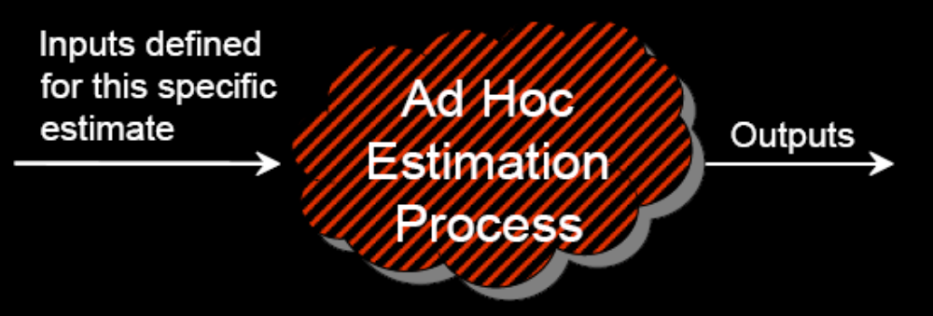
Chaotic Estimation Process
Tips: Don’t debate the output of an estimate. Take the output as a given. Change the output only by changing the inputs and re-computing.

Slide 38
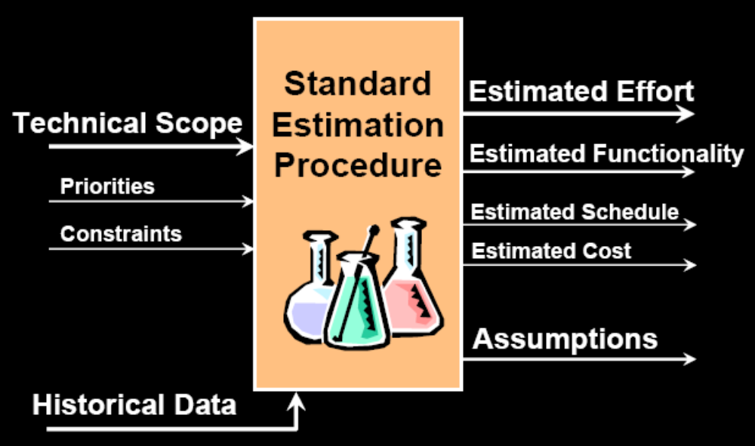
What’s a Good Estimation Process?
* Estimation on a well-estimated project, specific inputs of technical scope, priorities, and constraints are considered. These inputs can be adjusted until the estimation process produces an acceptable outcome.

Slide 39
Standard Flow of Any Estimate
Focus on estimating size first. Then compute effort, schedule, cost, and features from the size estimate.
Schedule
Size
Effort
Cost
Features
Step1: To estimate size only very early in a project, having requirements, stories, use cases, or something else can be counted;
Step 2: Effort is computed from the size estimate by using historical productivity data;
Step 3: Schedule, cost, and features are computed from the effort estimation.

Slide 40
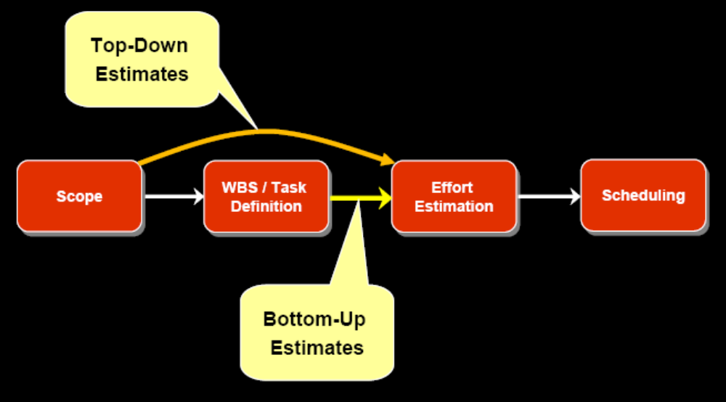
Where Does Estimation Fit?

Slide 41
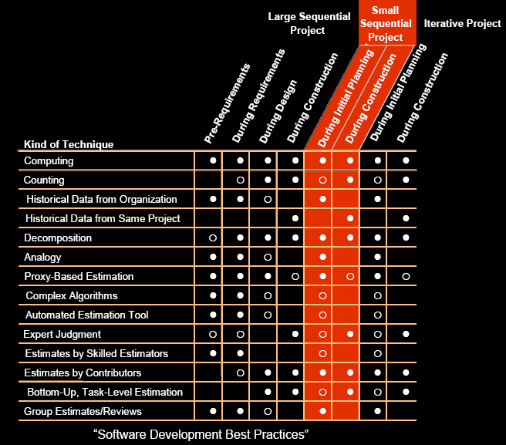
Preferred Estimation Methods by Project Stage
Re-estimation does not consist of simply doing the same estimation work again.
It consistent of converting to more accurate approaches as the project progress.
When you re-estimate in response to a missed deadline, base the new estimation on the project’s actual progress, not on the project’s planned progress.

Slide 42
Estimation Flow for Large Projects
Very early, you will be using algorithms, software tools, and other macro techniques;
You can still improve those early estimates with group reviews and by using multiple approaches;
As you move into later stages, you can move to more accurate, historical-data-based counting approaches and more toward micro techniques such as bottom-up task estimation, which will produce more accurate estimates.

Slide 43
Estimation Flow for Small Projects
Small projects estimate from the beginning the same ways that large projects estimate at the end.
As soon as you know the specific people who will be working on your project and can start handing out specific task assignments, it is time to bottom-up approaches based on individuals estimating their own assignments.

Slide 44
Standardized Estimation Procedures
Develop a Standard Estimation Procedure at the organizational level; use it at the project level
Protects against poor estimation practices (like guessing)
Protects against random changes to project estimates
Often there are different procedures for different types of projects

Slide 45
Usual Elements of a Standardized Procedure
Emphasizes counting and computing when possible, rather than using judgment
Calls for use of multiple estimation approaches and comparison of results
Communicates a plan to re-estimate at pre-defined points in the project
Defines how the required estimation approach changes over the course of a project
Contains a clear description of an estimate’s inaccuracy
Defines when an estimate can be used as the basis for a project budget
Defines when an estimate can be used as the basis for internal and external commitments
Calls for archiving estimation data and reviewing effectiveness of the procedure

Slide 46
Two Bases for Refining an Estimate
Refining generic knowledge (deeper in the cone of uncertainty)
Refining project-specific knowledge (better calibration with data from the actual project team and full set of project dynamics)

Slide 47
Progressive Elaboration
We shouldn’t expect to know all details at the start of a project
All software work leverages progressive elaboration
Also can be though of as: Rolling wave planning

Slide 48
Refining the Estimate Based on
Project-Specific Calibration Data
The project itself generates data that can be used to refine an estimate
Comparing estimated vs. actual task level or module-level results can be used to recalibrate remaining work on a project
“Your Past Performance will be an Indicator of Future Performance”

Slide 49
Example of Refining an Estimate
Using Project Data
First 10 tasks were estimated to take 10 staff weeks
First 10 tasks actually took 12.5 staff weeks
30 more tasks remain; estimated effort is 30 staff weeks
Choices:
  1. Plan to catch up later?
  2. Add 2.5 staff weeks to remaining effort estimate?
  3. Add 25% to remaining effort estimate?

Slide 50
Thanks for Your Attendance
Questions

